Slide 1
Interfacing ADC with 8051
Engr. Shahzada Fahim Jan

Slide 2
We live in an analog world
Temperature, humidity, pressure, are analog.
We use transducers to convert physical quantity to electrical quantity such as voltage or current.
For interfacing these sensors to microcontrollers we require to convert the analog output of these sensors to digital so that the controller can read it. Some microcontrollers have built-in Analog to Digital Convertor (ADC) so there is no need for external ADC. For microcontrollers that don’t have internal ADC external ADC is used.

Slide 3
Well. 8051 doesn’t have an inbuilt ADC. So we have to use external ADC. There are many ADCs available.
ADC 0804
ADC 0808

Slide 4
ADCs (analog-to-digital converters) are among the most widely used devices for data acquisition
We need an analog-to-digital converter to translate the analog signals to digital numbers, so microcontroller can read them

Slide 5
ADC0804 interfacing with 8051
The ADC0804 is a converter from analog to digital 8 bits.
ADC0804 has only one analog input channel with digital output of eight bits that can be 256 values ​​of different measures.
The step size is adjusted by setting the reference voltage in pin9 the reference input voltage can be adjusted to allow encoding any smaller range for the entire 8-bit resolution analog voltage. When the voltage reference pin is not connected to the ADC0804, the reference voltage defaults to the operating voltage, ie, Vcc. The step size is 19.53mV 5V (5V / 256)

Slide 6
ADC0804 also needs a clock to operate. The conversion time of the analog value to a digital value depends on the clock source. An external clock can be given at the Clock IN pin. ADC 0804 also has an inbuilt clock that can be used in absence of an external clock. A suitable RC circuit is connected between the Clock IN and Clock R pins to use the internal clock.

Slide 7
ADC804 IC is an analog-to-digital converter
It works with +5 volts and has a resolution of 8 bits
Conversion time is another major factor in judging an ADC
Conversion time is defined as the time it takes the ADC to convert the analog input to a digital (binary) number
In ADC804 conversion time varies depending on the clocking signals applied to CLK R and CLK IN pins, but it cannot be faster than 110 μs

Slide 8

CLK IN and CLK R
CLK IN is an input pin connected to an external clock source
To use the internal clock generator (also called self-clocking), CLK IN and CLK R pins are connected to a capacitor and a resistor, and the clock frequency is determined by
Typical values are R = 10K ohms and C = 150 pF
We get f = 606 kHz and the conversion time is 110 μs

Slide 9
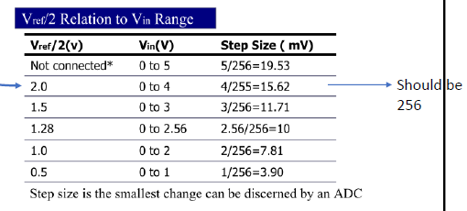
Vref/2
It is used for the reference voltage If this pin is open (not connected), the analog input voltage is in the range of 0 to 5 volts (the same as the Vcc pin) If the analog input range needs to be 0 to 4 volts, Vref/2 is connected to 2 volts

Slide 10

D0-D7 The digital data output pins
The converted data is accessed only when CS = 0 and RD is forced low To calculate the output voltage, use the
following formula
Dout = digital data output (in decimal), Vin = analog voltage, and step size (resolution) is the smallest change

Slide 11
Analog ground and digital ground
Analog ground is connected to the ground of the analog Vin
Digital ground is connected to the ground of the Vcc pin

Slide 12
The following steps must be followed
for data conversion by the ADC804 chip
Make CS = 0 and send a low-to-high pulse to pin WR to start conversion
Keep monitoring the INTR pin
If INTR is low, the conversion is finished
If the INTR is high, keep polling until it goes low
After the INTR has become low, we make CS = 0 and send a high-to-low pulse to the RD pin to get the data out of the ADC804

Slide 13
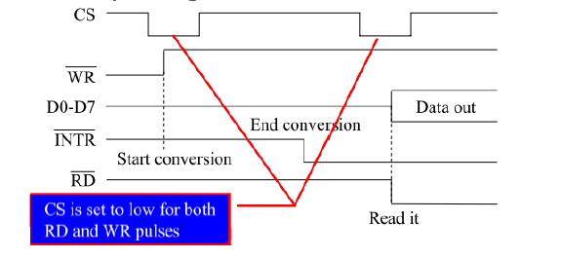

Slide 14
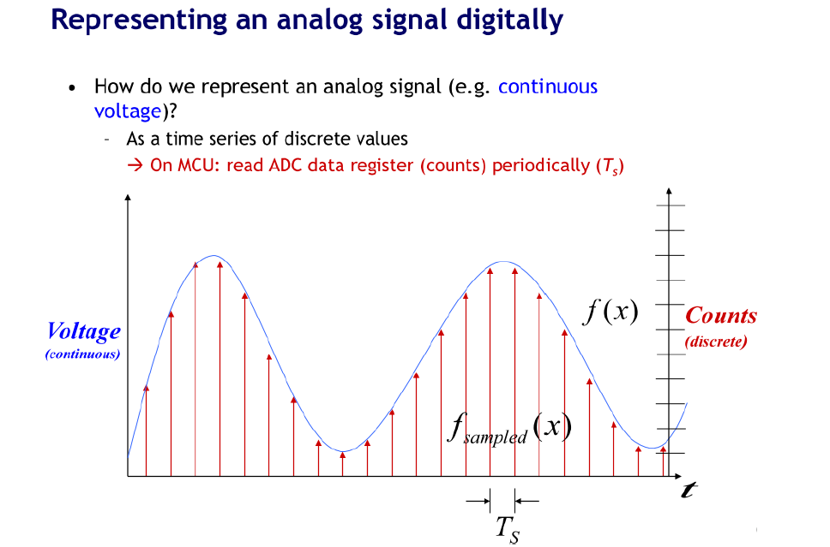

Slide 15
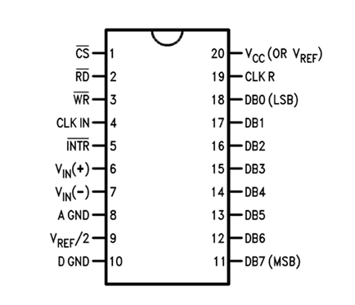
ADC0804

Slide 16
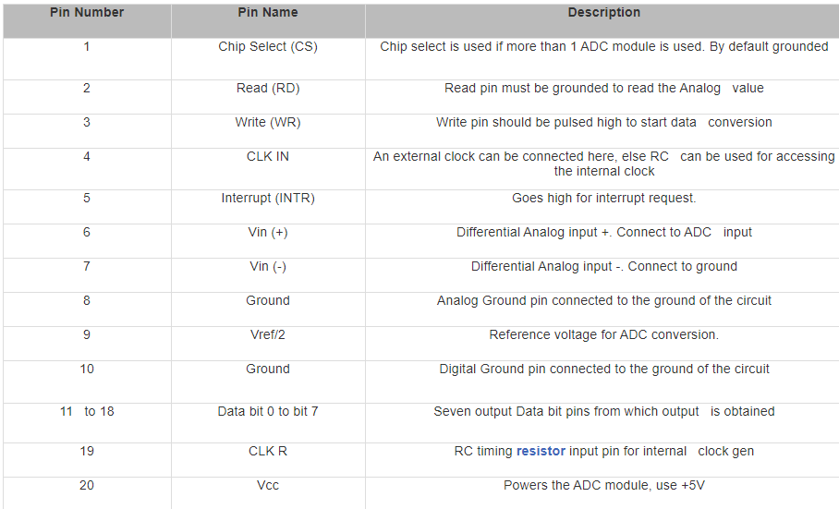

Slide 17
How to use the ADC0804?
Make Cs(chip select) low(0) to activate the IC. Here we are directly connecting that CS into Ground instead of connecting into 8051.
Make WR(write) pin low (0).
Make RD(read) pin high (1).
Make WR(write) pin high (1) after some delay small delay//This low to high impulse at WR pin starts your conversion.
Now check the INTR(interrupt) pin if it is high(1) conversion is running if it is low(0) the conversion is over.
Make RD=low(0) .

Slide 18
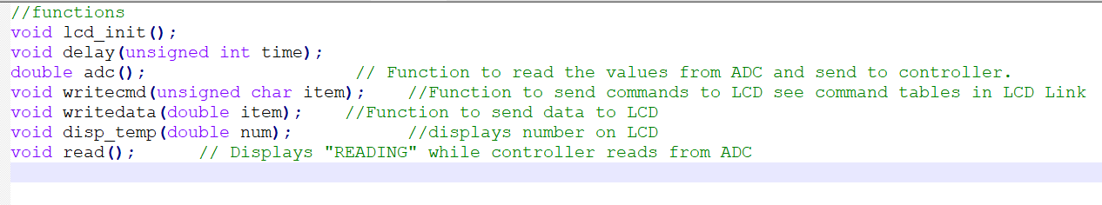

Slide 19
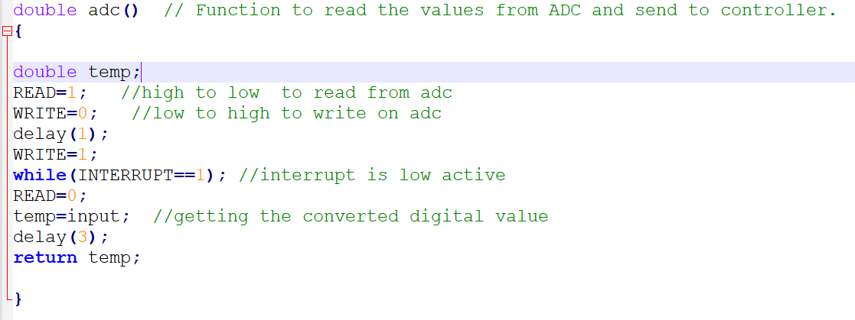

Slide 20
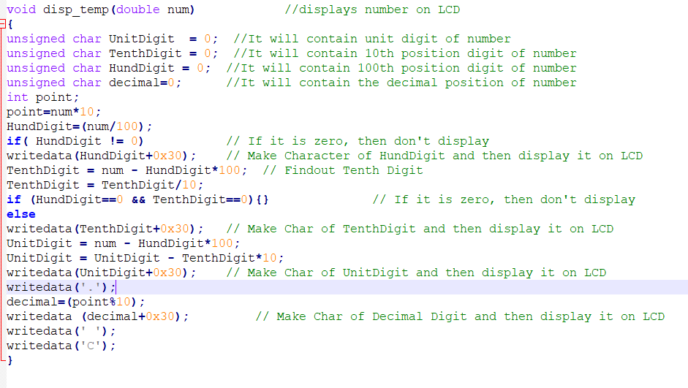

Slide 21
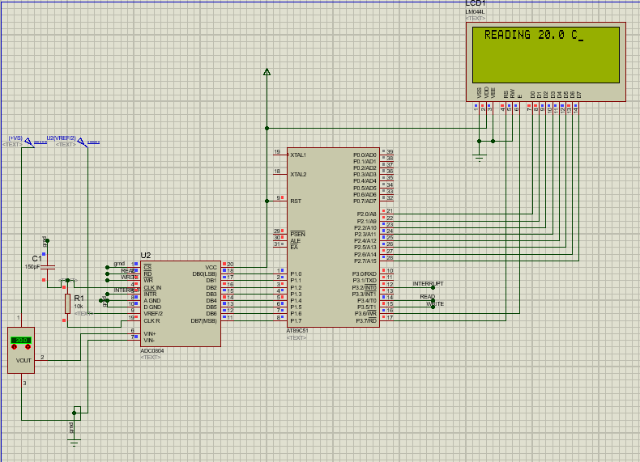

Slide 22
TASK
From temperature sensor (LM35) read temperature and convert it into Digital value by using ADC0804 and display the value on the LCD. In LCD at first line write your registration Number and on the second line display the value of the temperature sensor attached with ADC0804.

